Slide 1
Introduction to LLM (Large Language Model) Applications on AMD Platforms
黃彥勲
Sean Huang
Notes:
在AMD平台打造您的大型語言模型(LLM)應用

Slide 2
Lesson Outline
Theoretical Component
Foundations of LLMs
Basics of LLM Fine Tuning
Retrieval-Augmented Generation (RAG)
Function Calling Implementation
Practical Component
Difference Between Nvidia/CUDA and AMD/ROCm Platforms
Interfacing with the MI300 Server
RAG Using MI300 Generator and Local Data
Function Calling Implementation
AMD Programmer Certification
Appendix
Preparations for Working With LLMs
LLM Deployment Using Transformers
LLM Deployment Alternatives

Slide 3
Goals
There are two primary goals for today’s panel:
We want to instruct a LLM to interact with external APIs to perform a task for us (via function calling) – this is the foundation of creating an AI agent
We want to update a LLM's existing knowledge with and without using fine tuning
As you will find out, there are many ways to do this
To accomplish this, we will be discussing a series of LLM related concepts and tools

Slide 4

Speaker Introduction
Name: Sean Huang (黃彥勲)
Profession: Software Engineer (ITRI)
Research Interests: LLMs and AI safety in agentic systems
Education:
PhD in Computer Science (2025 - Present) - National Yang Ming Chiao Tung University
MS in Computer Science (2021 - 2022) - Georgia Institute of Technology
BSE in Computer Engineering (2016 - 2020) - University of Michigan

Slide 5
Foundations of LLMs

Slide 6
What is a LLM?
LLM (Large Language Model) is a transformer-based neural network for natural language understanding and generation
Transformer is built around attention (as opposed to CNN’s convolution)
Transformer’s scope is global, allowing it to associate information from distant patches
Trained on massive text datasets to learn patterns in language, knowledge, and reasoning
Generates output by predicting the next token given prior context
Supports tasks such as Q&A, summarization, translation, and code generation
Can be extended with prompting: retrieval (RAG) and function calling are examples of this

Slide 7
Background For LLMs: Tokenizer
What are tokens?
LLMs need tokenizers to convert strings into tokens (numerical IDs) that the model can understand
Working with numerical values (float/int) is easier than strings
Every model has their own tokenizer
To better generalize unseen vocabulary during training, words are broken down into smaller parts (so one word can be more than one token)
Word seen during training: “unavailable”
“un” → 42
“avail” → 189
“able” → 76
New unknown word seen during inference: “unimaginable”
“un” → 42
“imagine” → ?
“able” → 76
Token 42 = not/opposite
Token 76 = can
So “unimaginable” should have a meaning related to being unable to do something
Notes:
Tokenizer set during training; if you use a tokenizer for one model on a different model, the output will break

Slide 8
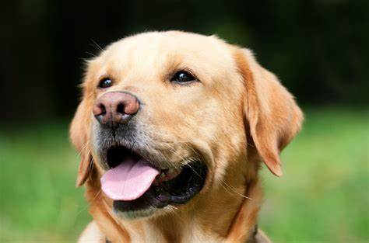

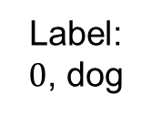



Comparison With CNN
CNN steps: convert image to matrix → inference → f(output)
Function f can be argmax for classification, for example
LLM steps: tokenize (string to token) → inference (generate) → decode (token to string)
Tokenization example:
"ChatGPT is amazing!" → ['Chat', 'G', 'PT', ' is', ' amazing', '!’] → [12345, 678, 91011, 314, 56789, 42]
cv2
$$\left[\begin{matrix}1 & 2 & 3 \\ 4 & 5 & 6 \\ 7 & 8 & 9\end{matrix}\right]$$
matmul
CNN
argmax
$$\left[\begin{matrix}1 & 2 & 3 \\ 4 & 5 & 6 \\ 7 & 8 & 9\end{matrix}\right]$$
Label: $0$, dog
$$\left[\begin{matrix}1 & 2 & 3 \\ 4 & 5 & 6 \\ 7 & 8 & 9\end{matrix}\right]$$
$$\left[\begin{matrix}0.8 & … & 0.1\end{matrix}\right]$$
Image
augmentation
tokenize
matmul
LLM
decode
“How are you?”
$$\left[\begin{matrix}1 & … & eos\end{matrix}\right]$$
$$\left[\begin{matrix}8 & … & eos\end{matrix}\right]$$
“I’m doing great”

Slide 9
What LLMs Are Out There?
GPT, Deepseek, Llama, gemma, Taide, Breeze, Mistral, Internvl, Qwen…
Each model has their own strengths and weaknesses:
GPT: most well rounded option out there, but not open source and not commercially hostable
Breeze: has Traditional Chinese support + open source + commercially viable (3B, 8B)
Gemma4: enhanced coding capabilities
More and more recent models are capable of function calling – it’s all about picking what suits your use case best (model size, multi-lingual support, etc.)
Newer models have better text comprehension and some models that weren’t trained to do function calling can still perform basic FC if taught in prompts
Why do we need fine tuning then?
Stability, formatting, some smaller models really don’t have one-shot learning capability because they can’t generalize well enough

Slide 10
Basics of LLM Fine Tuning

Slide 11


Full Fine Tuning
Like the name suggests, this updates all model parameters during training
Pros:
Cons:
Best performance when trying to train a model for a specific task
Modifies core model behavior (reasoning, output format)
Used to create foundational models
Very demanding resource wise (time, VRAM, checkpoint storage, data required)
Easy to overfit on small datasets and forget old skills

Slide 12
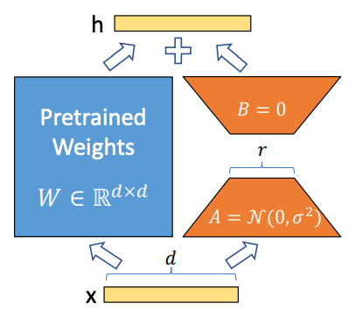
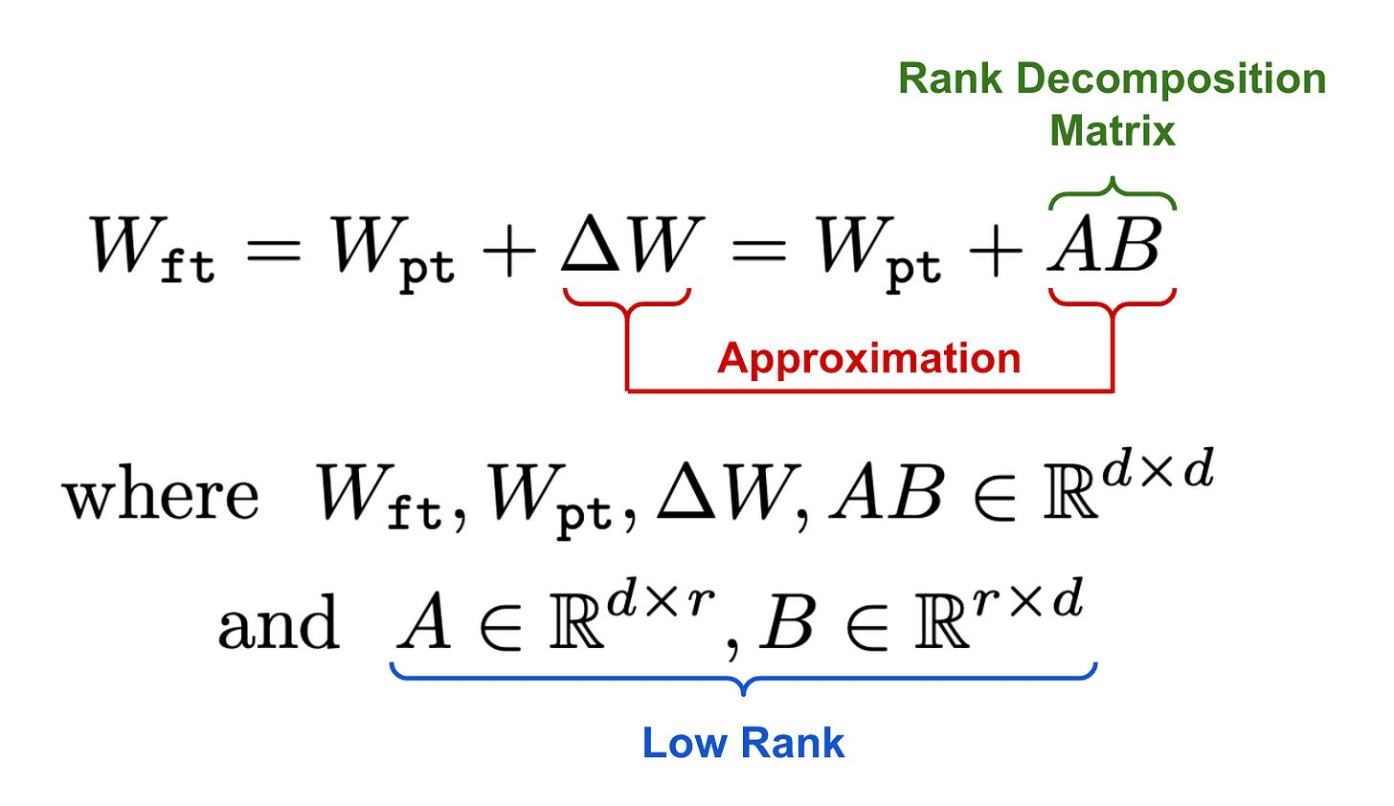
Low-Rank Adaptation (LoRA)
How It Works:
Freeze the pre-trained LLM weights.
Add small trainable low-rank matrices (A & B) to attention layers.
Train only these new matrices, keeping the original model intact.
The trainable weights are then merged with the base model.
Notes:
initialize A with random, small values, while B is initialized as zero, ensuring that we begin the finetuning process with the model’s original, pretrained weights

Slide 13
Low-Rank Adaptation (LoRA)
Key Benefits:
✅ Reduces Memory Usage – Fine-tunes only a small fraction of the model parameters. ✅ Faster Training – Requires fewer computations, making it cost-efficient. ✅ Retains Pre-Trained Knowledge – Keeps most of the original model weights frozen. ✅ Easier Adaptation – Fine-tune large models (e.g., LLaMA, Mistral) on consumer GPUs. ✅ No Added Inference Latency – doesn’t slow down model.
Use Cases:
Fine-tuning LLMs on domain-specific data (e.g., medical, legal, finance) and special formatting
Fine tuning on limited hardware
When you only want to partially modify model performance while maintaining core behavior

Slide 14
Retrieval-Augmented Generation (RAG)

Slide 15
What is RAG (Retrieval-Augmented Generation)?
Problem: LLMs like GPT are trained on massive datasets, but they:
Can hallucinate (make up facts)
Do not have any knowledge of current events after their training cutoff date
Can’t access private or custom data during pretraining
For smaller models, they lack domain specific expertise
Solution: RAG
Step 1: Retrieve relevant documents from an external database (e.g., PDFs, websites)
Step 2: Generate an answer using both the user question and the retrieved content
This makes responses:
✅ More accurate
✅ More up-to-date
✅ Customizable to your domain
All without fine-tuning!

Slide 16
RAG Encoder
How does the retrieval system know which documents are relevant?
With RAG, you are working (generally) with 2 models
LLM model (generator) that answers your questions
Embedding model (encoder) that maps your question into the same vector space as your dataset (vector store)
The vector store finds the most similar documents (top-k) to the query vector (cosine similarity)

Slide 17
An Example RAG Framework
Query
Output
……
LLM
……
Top k most relevant context (cosine)
encoder
----------
----------
----------
encoder
(offline)
Reference documents
Vector database

Slide 18
RAG At Work
If you use an older model like gemma-2-2b-it and ask it:
Do you have any information on who the president of the United States is in 2025?
It will respond with:
I do not have access to real-time information, including future events. Therefore, I cannot tell you who the President of the United States will be in 2025.
With RAG:
According to the news sources you provided, the President of the United States in 2025 would be **Donald Trump**.

Slide 19
When to Use RAG?
Most tasks can be accomplished with RAG (without fine tuning the model)
To draw a parallel with CNNs, RAG is similar to using data augmentation (prompt engineering) and few shot learning to circumvent fine tuning
Applications:
Domain specific QA: customer service, automatic inspection
Personalized service: can't be expected to load entire chat history or fine tune model for every user
Cheaply update model while maintaining model's core behavior

Slide 20
Function/Tool Calling: Using Natural Language to Interface with External APIs

Slide 21
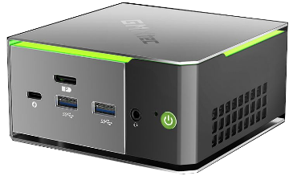

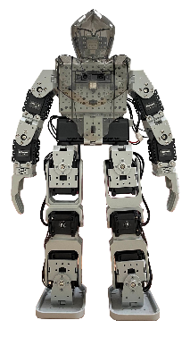

Tools/Function Calling
Objective: using the semantic understanding of large language models (LLMs), convert a user’s unstructured command into control signals for other applications with function calling
For LLMs, function calling refers to when the LLM infers the correct function to call and its input parameters from the user prompt
Applications: AI agents (Openclaw, Claude Code), IoT, search (retrieve real-time data online or from local database), automated customer service (banking, booking)
Take two steps forward
[00 01 11 00]
Controller
Whisper
Gemma 2 2B
API
Speech to text
Decide which function to use and convert text to JSON
Using JSON data fields as input, call function
Spoken command as input
{“function”: “perform_action”, “action”: “walk forward, …”}
Perform action

Slide 22
Essential Components of Function Calling
Model: does the model support function calling?
Prompt: do the function descriptions describe the task clearly? Is the prompt clear?
External API: does the application have API support?

Slide 23
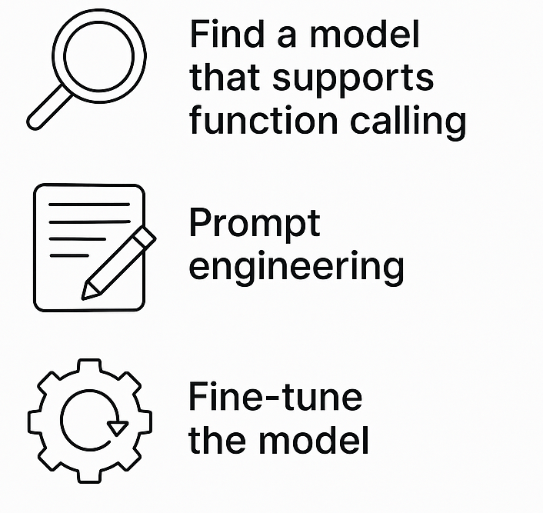
What Happens If You Lack the Essential Components?
Model: the model does not support function calling
GPT, mistral, deepseek, breeze, phi, gemma
(If model has good comprehension) Adjust function descriptions, provide examples for few shot learning
Train the model on public/custom function calling datasets*
Notes:
You can do anything you want if you fine tune the model

Slide 24
What Happens If You Lack the Essential Components?
Prompt: if the model supports function calling/has good text comprehension, how can you improve function calling performance in the following cases?
Function output format is incorrect
Few shot learning, use special tokens (<functional>, etc.)
Some functions are not getting called/called more than others
Check max input size, make sure there isn’t too much overlap between functions
The model only outputs formatted text and lost the ability to chat normally
Adjust system prompt to instruct model to only use function call when applicable, consider using multi-agent systems (one for parsing functions, another for chatting)

Slide 25
What Happens If You Lack the Essential Components?
External API: does the application have official API support?
Yes
Then there’s no problem, just pick out the functions you need and determine what parameters to parse as inputs
No
Hack the application and write your own API
Find alternative applications

Slide 26
Our Model Can Call Functions, Now What?
✅ Model: does the model support function calling?
❓️ Prompt: do the function descriptions describe the task clearly? Is the prompt clear?
❓️ External API: does the application have API support?
Before we craft our prompt, we need to know what task we are performing.

Slide 27
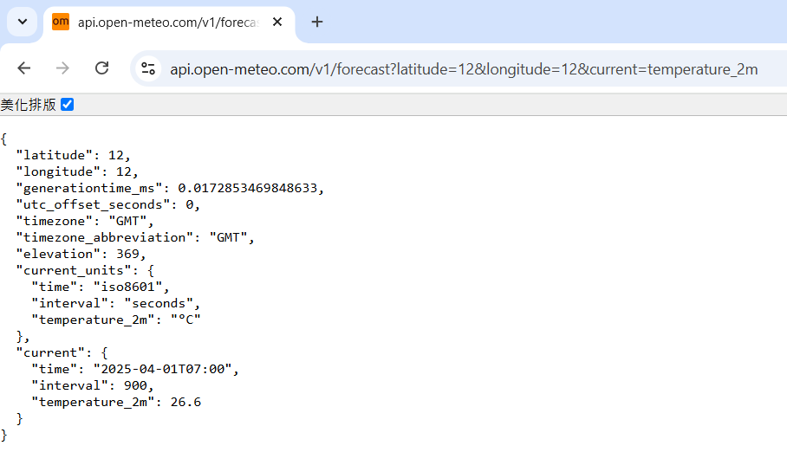
Our Model Can Call Functions, Now What?
Decide on which API you are using:
Example: Open-Meteo (free open source weather
forecast API)
Pick out the functions you will use:
Example: get_weather(latitude, longitude)
Input: (12, 12)
Output: json with current time and temperature
Request: https://api.open-meteo.com/v1/forecast?latitude=12&longitude=12&current=temperature_2m
API supports other functions like wind speed, hourly temperature, etc.
Next step: crafting functions/tools for LLM to use (description + prompts = use these APIs)
Open-Meteo’s API returns an easily parsed json
Notes:
latitude

Slide 28
Function Calling Prompt Crafting
A prompt for function calling contains the following:
General direction/role assignment
Function list
Function name
Description
Function parameter names
Function parameter descriptions
Required inputs
(Optional) Desired output format

Slide 29
Function Calling Prompt Crafting
General direction/role assignment
Example: “You are a helpful assistant with access to the following functions. Use them if required - ”
Assigning a role to a LLM can influence its output:
This affects tonal style, how strict/loose the model should be when deciding whether it should use functions or chat normally
Example: “You are a reliable, trustworthy expert on semiconductor manufacturing. You can answer anything related to your domain of expertise but you must decline to answer when asked about other topics. When applicable, use the functions provided below to help answer the query:”

Slide 30
Function Calling Prompt Crafting
Function list: a function list includes all of the functions you want the LLM to be able to call
You can think of this as a header file for the LLM
Comments are IMPORTANT

Slide 31
Function Calling Prompt Crafting
A single function in the list will have these parameters:
Function name: name of the function
Description: what the function does, when it should be used, how it should be used; as a rule of thumb, if an intern can’t tell how this function works, the LLM won’t be able to either
Function parameter names: the names of the inputs to the function
Function parameter descriptions: function input properties (bool, enum), can include textual description for complex use cases
Required inputs: which inputs must be included
Function output is not explicitly written in the parameters (but usually included in function description)
This is because the LLM’s job is to turn natural language into f(x), the API is what handles the output generation

Slide 32
Function Calling Prompt Crafting
Function declaration example:
Function name: get_weather
Description: Get the current temperature for the provided coordinates in Celsius.
Function parameter names: latitude, longitude
Function parameter descriptions: {"type": "number"} (additional comments and enumerator rule not needed)
Required inputs: latitude, longitude

Slide 33
Function Calling Prompt Crafting
Desired output format:
Some LLMs are already trained on function calling datasets and can output structured data
Sometimes, it can still be useful to specify a particular output format to improve stability
Recommended ways to format outputs:
Json
Token delimiters
Example:
If a function should be used, respond with the function name and its parameters in json format like so:
{"name": "function_name", "arguments": {"arg_1": "value_1", "arg_2": "value_2", ...}}

Slide 34
Putting Everything Together
You are a helpful assistant with access to the following functions. Use them if required -
{
"name": "get_weather",
"description": "Get the current temperature for the provided coordinates in Celsius.",
"parameters": {
"type": "object",
"properties": {
"latitude": {"type": "number"},
"longitude": {"type": "number"}
},
"required": ["latitude", "longitude"]
}
}
If a function should be used, respond with the function name and its parameters in json format like so:
{"name": "function_name", "arguments": {"arg_1": "value_1", "arg_2": "value_2", ...}}
User Query:

Slide 35
A More Complex Example
You are a helpful assistant with access to the following functions. Use them if required -
{
"name": "get_action_set",
"description": "Get the series of actions and the number of times each action needs to be performed in order",
"parameters": {
"type": "object",
"properties": {
"actions": {
"type": "array",
"description": "The actions that need to be performed in the order that is specified by the user. If an action has to be performed multiple times, then repeat the action entry for the same number specified by the user, e.g. "Take two steps forward" would turn into ["walk forward", "walk forward"]." ,
"items": {
"type": "string",
"enum": ["bow", "cheer", "scratch head", "handstand", "sit", "stand", "stabilize", "walk forward", "walk backward", "walk left", "walk right", "turn right", "turn left"],
}
},
},
"required": ["actions"]
}
}
If a function should be used, respond with the function name and its parameters in json format like so:
{"name": "function_name", "arguments": {"arg_1": "value_1", "arg_2": "value_2", ...}}
User Query:
Descriptions are useful when the parameter has special rules or is unintuitive (generally good to have regardless)
Enums are useful when you only expect a fixed set of values in the field

Slide 36
We Have Our Model and Prompt, Now What?
✅ Model: does the model support function calling?
✅ Prompt: do the function descriptions describe the task clearly? Is the prompt clear?
❓️ External API: does the application have API support?
The easy part. Integrate the LLM pipeline with your chosen API

Slide 37
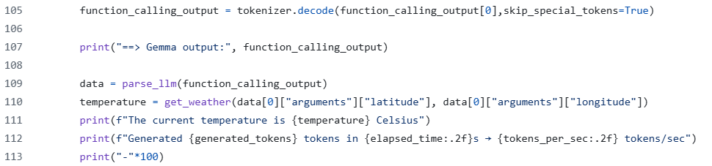
System Integration
Prepare your API calls to take in the inputs you specified
Prepare the API functions you require
LLM output
API call using LLM output as parameters

Slide 38

Before We Continue
For those who would like to run the demos during the practical section, the code will be available at: https://github.com/jonathansimple/intro-to-llms
The relevant programs are in the vllm folder
QR code to the GitHub repo

Slide 39
Difference Between Nvidia/CUDA and AMD/ROCm Platforms

Slide 40
Difference Between AMD and Nvidia Platforms
Platform | Driver | Library | Source Code | Operating System
AMD | ROCm | ROCm-compliant libraries (ex. torch==2.8.0+rocm7.2) | No difference | Linux, partial Windows support
Nvidia | CUDA | CUDA-compliant libraries (ex. torch==2.8.0+cu126) | No difference | Linux, Windows
Drivers & Library:
To make use of hardware (GPU) acceleration features, the platform specific version of the Python library/packages and the correct hardware drivers need to be installed.
For Windows ROCm support, you will need to look into the rocm.nightlies.amd.com wheels for ROCm compatible Pytorch drivers
Source Code:
Code for both ecosystems remains exactly the same. Keywords used in CUDA environment such as model.to(“cuda”) is used for both ROCm and CUDA projects.
For server API calls (OpenAI, vLLM, Ollama, etc.), the method for sending requests is the same for both platforms
Operating Systems:
If you wish to run ROCm on Windows, you will need to use wsl.

Slide 41
Setting Up Your Environment
For today, you don’t need to worry about having an AMD PC/laptop or setting up ROCm
You can apply for a free user account to use the ITRI MI300 server; to set up a ROCm environment on MLSteam, you’ll need to use Docker images provided by AMD
You can use any computer/laptop for today’s in-lecture demo (AMD/Nvidia/CPU only devices are all compatible)
The demos are quick and uses very lightweight local models or offloads heavy computation to the AMD server

Slide 42
Interfacing with the MI300 Server

Slide 43
MI300 Server Information
VRAM capacity: 192 GB
Server IP: 210.61.209.139
Models are hosted via vLLM
Qwen/Qwen3-30B-A3B (port 45600)
You can interact with the server through the Python openai library
Run pip install openai
Access deadline: 5/3/2026
Notes:
vllm serve Qwen/Qwen3.5-122B-A10B-FP8 --port 8000 --tensor-parallel-size 1 --max-model-len 16384 --reasoning-parser qwen3 --enable-auto-tool-choice --tl-call-parser qwen3_coder
vllm serve Qwen/Qwen3-30B-A3B --port 8000 --tensor-parallel-size 1 --max-model-len 16384 --reasoning-parser qwen3 --enable-auto-tool-choice --tool-call-parser hermes

Slide 44
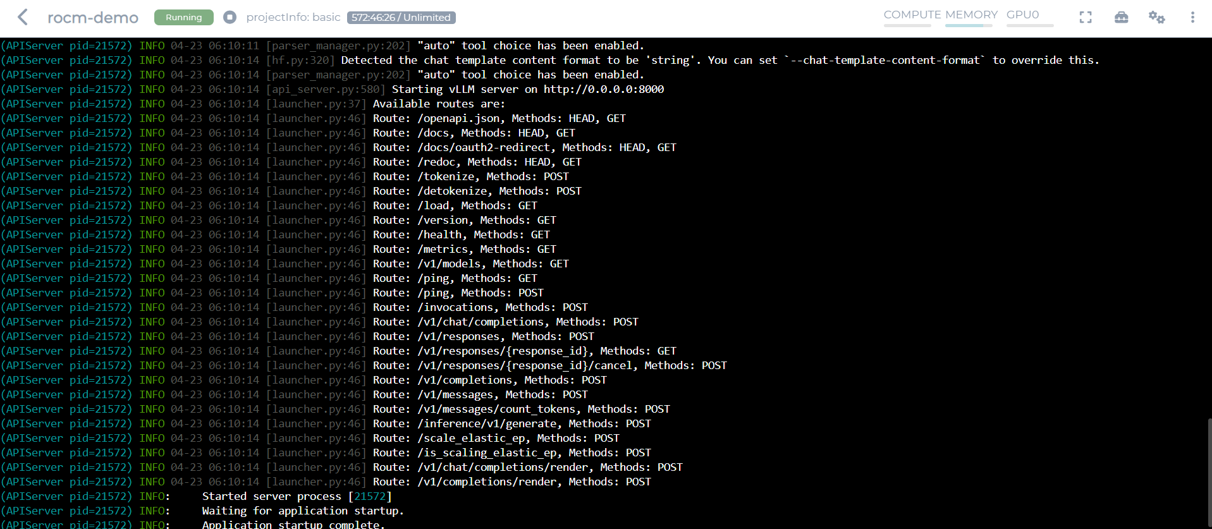
vLLM Interface
Gets the active model’s information, fast command that is good for making sure you can connect to the server
The API you use to send queries to the LLM

Slide 45
How to Access Server Resources
You can query the server via command line or Python:
Terminal/Command Line (Windows):
To see the model information of the LLM hosted at the given port and to test connection to server:
curl.exe 210.61.209.139:45600/v1/models
To send a request to the server:
curl.exe -s http://210.61.209.139:45600/v1/chat/completions -H "Content-Type: application/json" --data-raw "{\"model\":\"Qwen/Qwen3-30B-A3B\",\"messages\":[{\"role\":\"user\",\"content\":\"Hi\"}]}"

Slide 46
How to Access Server Resources
To send a request to the server in Python:
from openai import OpenAI
client = OpenAI(
base_url="http://210.61.209.139:45600/v1", # your vLLM server
api_key="token-abc123", # you must include this field but it won’t be used, fill with dummy values
)
resp = client.chat.completions.create(
model="Qwen/Qwen3-30B-A3B", # replace with your served model name that you found via curl
messages=[
{"role": "user", "content": “Hi"},
],
temperature=0.7,
max_tokens=8192,
extra_body={"top_k": 50},
)
print(resp.choices[0].message.content)

Slide 47
RAG Using MI300 Generator and Local Data

Slide 48
Problem Rehash
Why RAG?
Some models have outdated information, but we don't want to find tune the model
Difference between RAG and normal inference:
Additional context for generation is provided (normally you only have the query)
As a result, your prompt will look different
Here is a very simple RAG prompt:
Context: Donald Trump won the 2024 presidential election and remains president in 2025. Most new models can perform function calling out-of-the-box.
Question: Who is the president of the United States in 2025?
Answer:

Slide 49
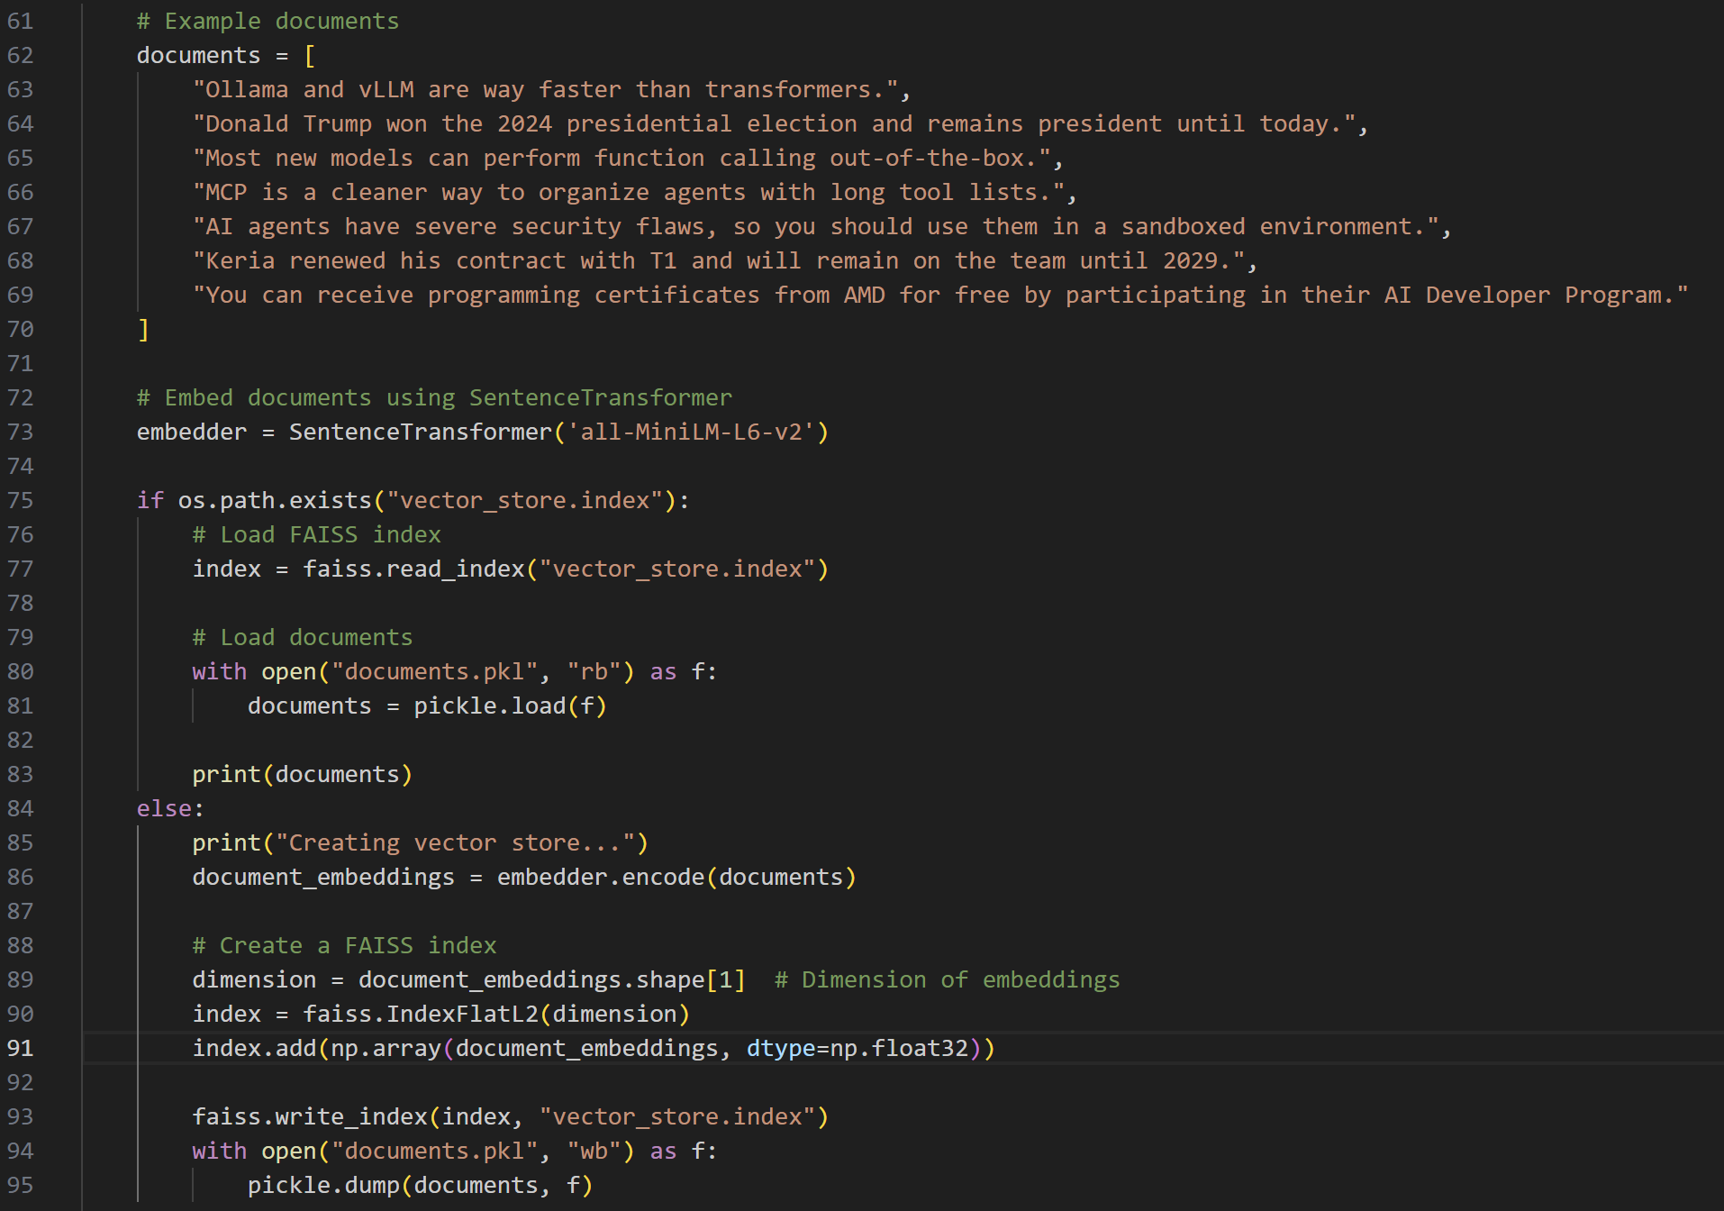
Building a Vector Store for Retrieving Relevant Context (vllm_rag.py)
Databases/vector stores are usually built offline (since they can take a long time to build if there are a lot of entries), then loaded into memory on launch
One of many examples of building a vector store using FAISS

Slide 50
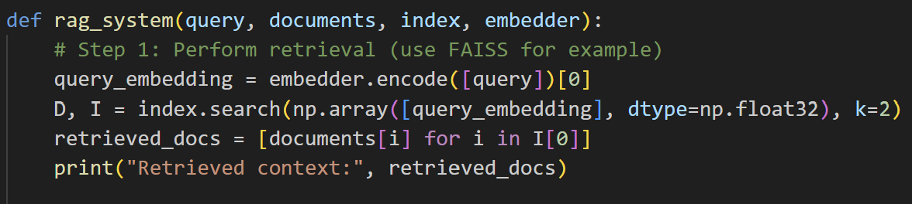
Retrieval Step (vllm_rag.py)
The first step in RAG is retrieval
We first convert the user query (string) into embedding
Then use similarity metrics (cosine) to find the data entries with the closest semantic overlap with our query
We then pick the top k (2 in our case) entries in the database to use for augmentation

Slide 51
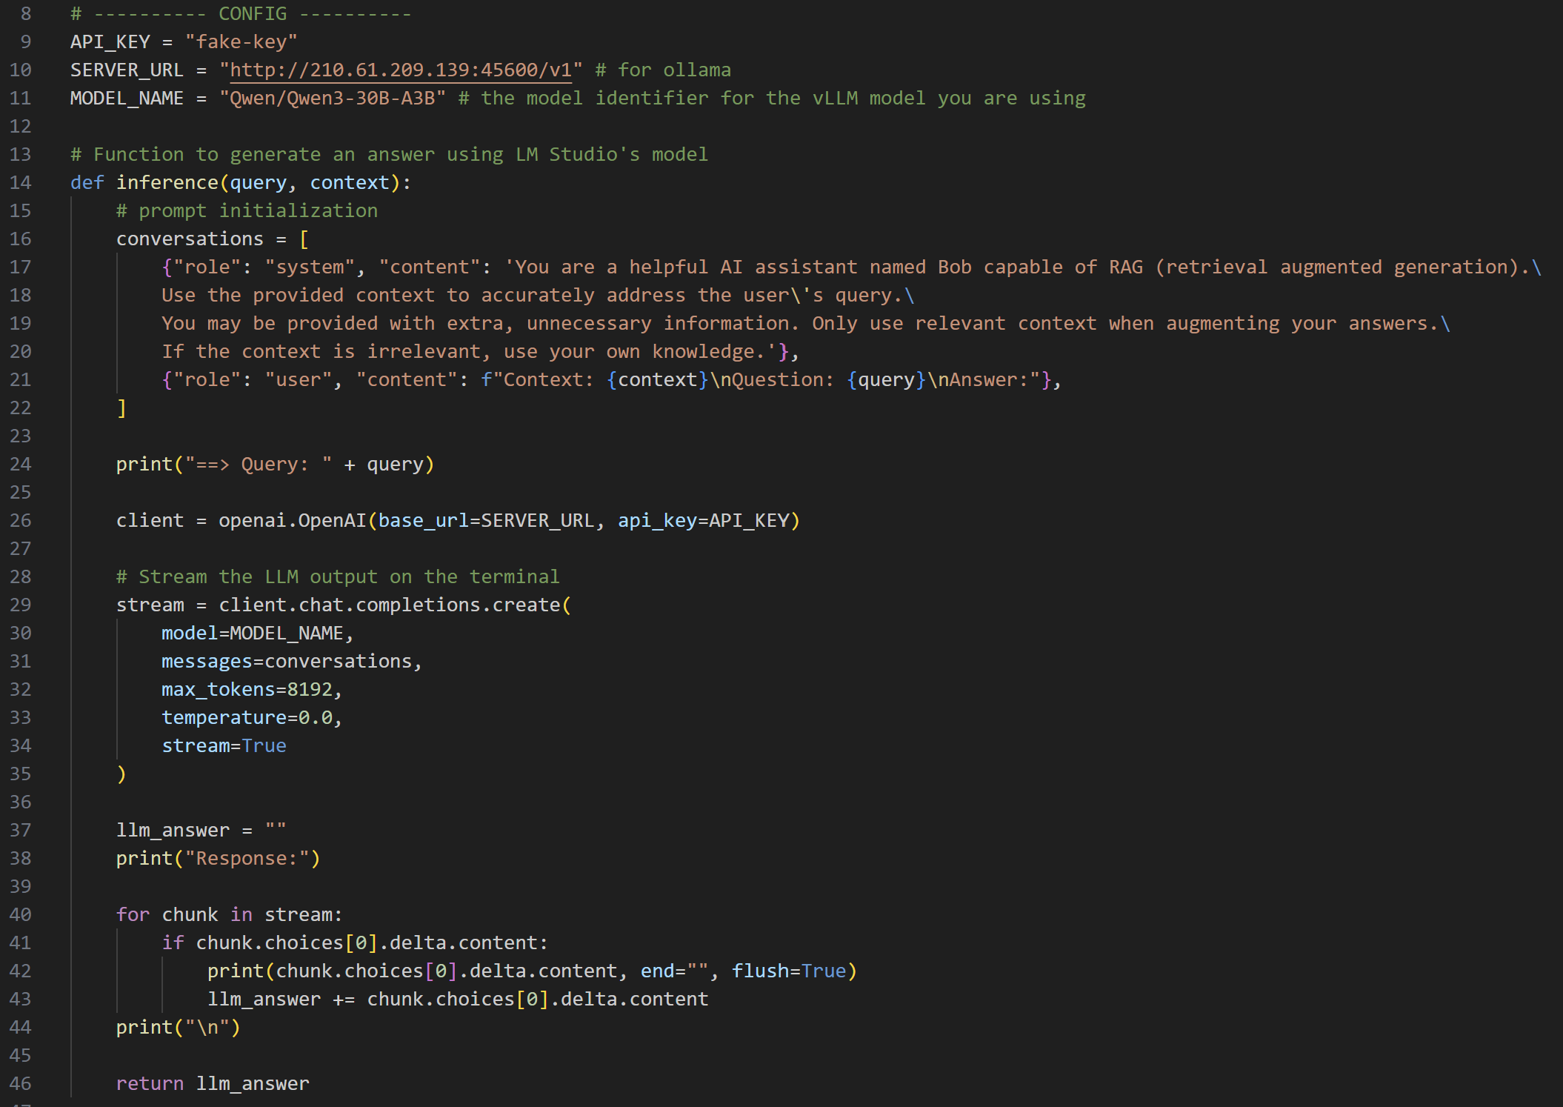
Generating a Response using vLLM (vllm_rag.py)
API call is similar to the unit test, the only difference here is that the system prompt and user prompt have been modified to be more RAG friendly, and server response is now streamed instead of returned in bulk.

Slide 52
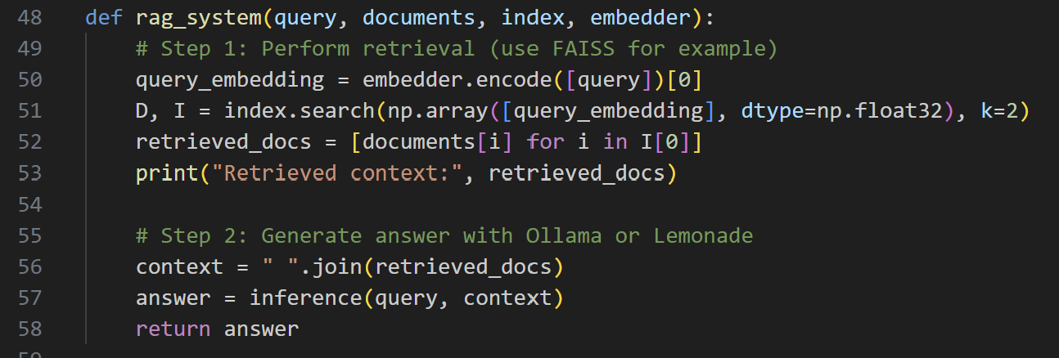
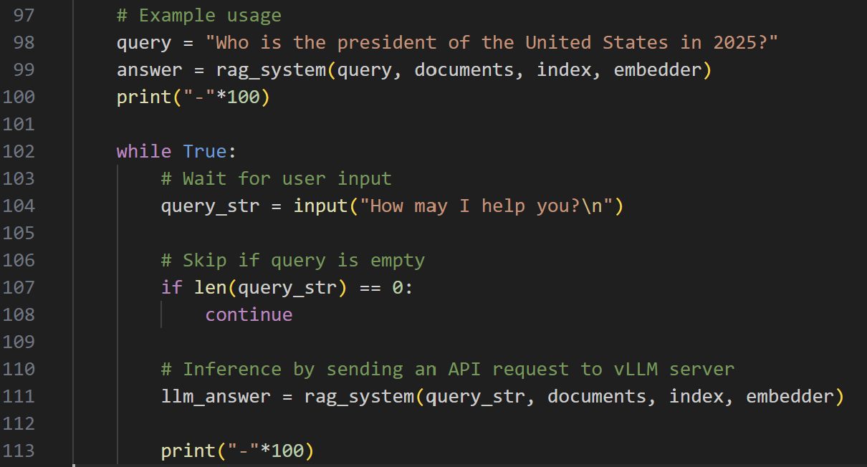
Putting Everything Together (vllm_rag.py)
Find the top 2 documents that most closely relate to the query
Concat the retrieved contexts for the RAG prompt
End-to-end RAG call

Slide 53
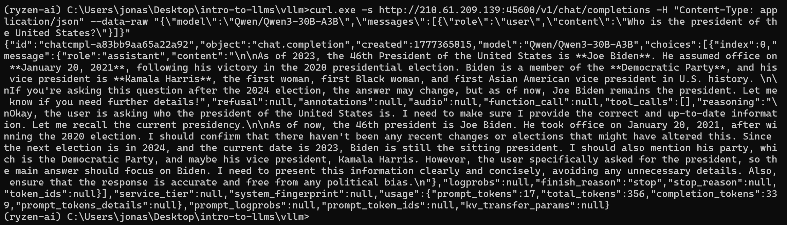
Without RAG
Even though the model is new, it may still have trained on old data.

Slide 54
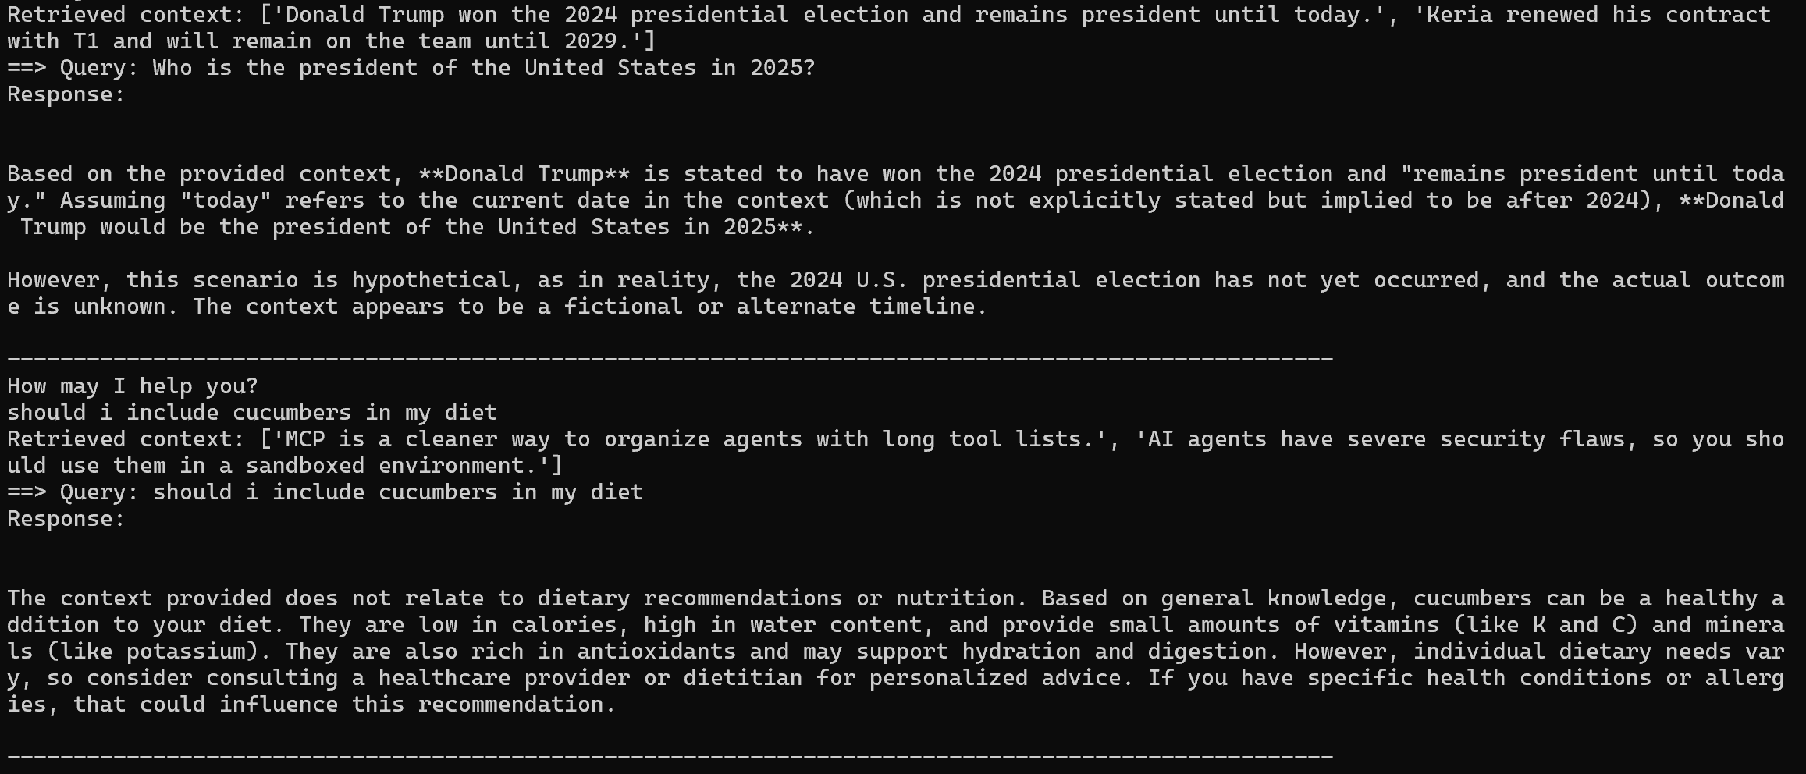
RAG Using vLLM (vllm_rag.py)

Slide 55
Function Calling Implementation

Slide 56
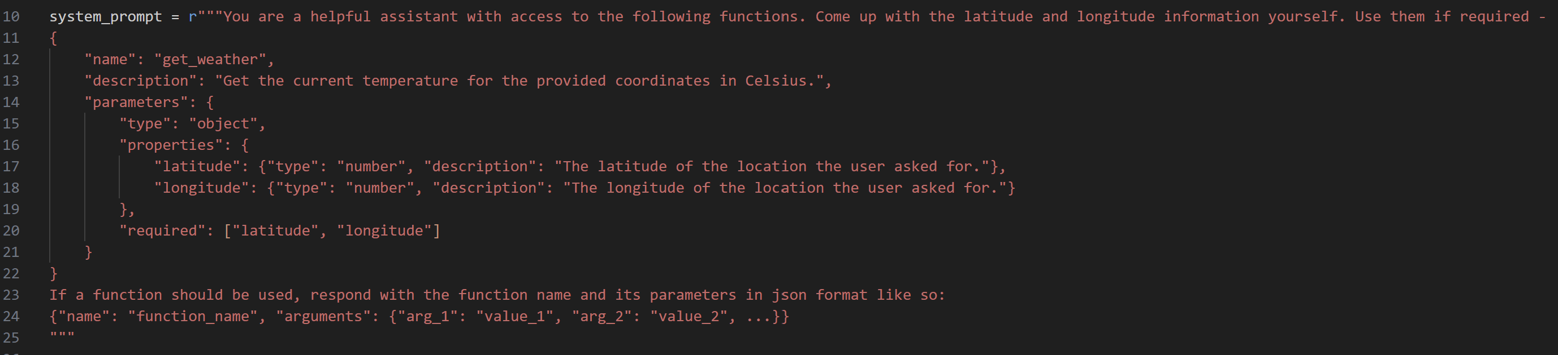
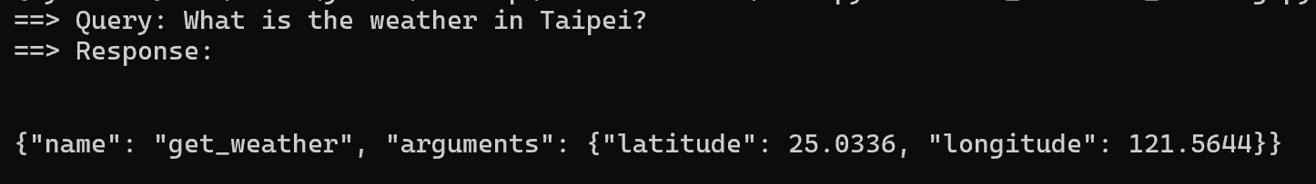
Function Calling Example: Function Declaration (vllm_function_calling.py)
The description fields are important for informing the LLM on when a function should be used
Sample output, the model provides the coordinates to Taipei using its existing knowledge. You can also opt to add another tool that uses web search to get the coordinates

Slide 57
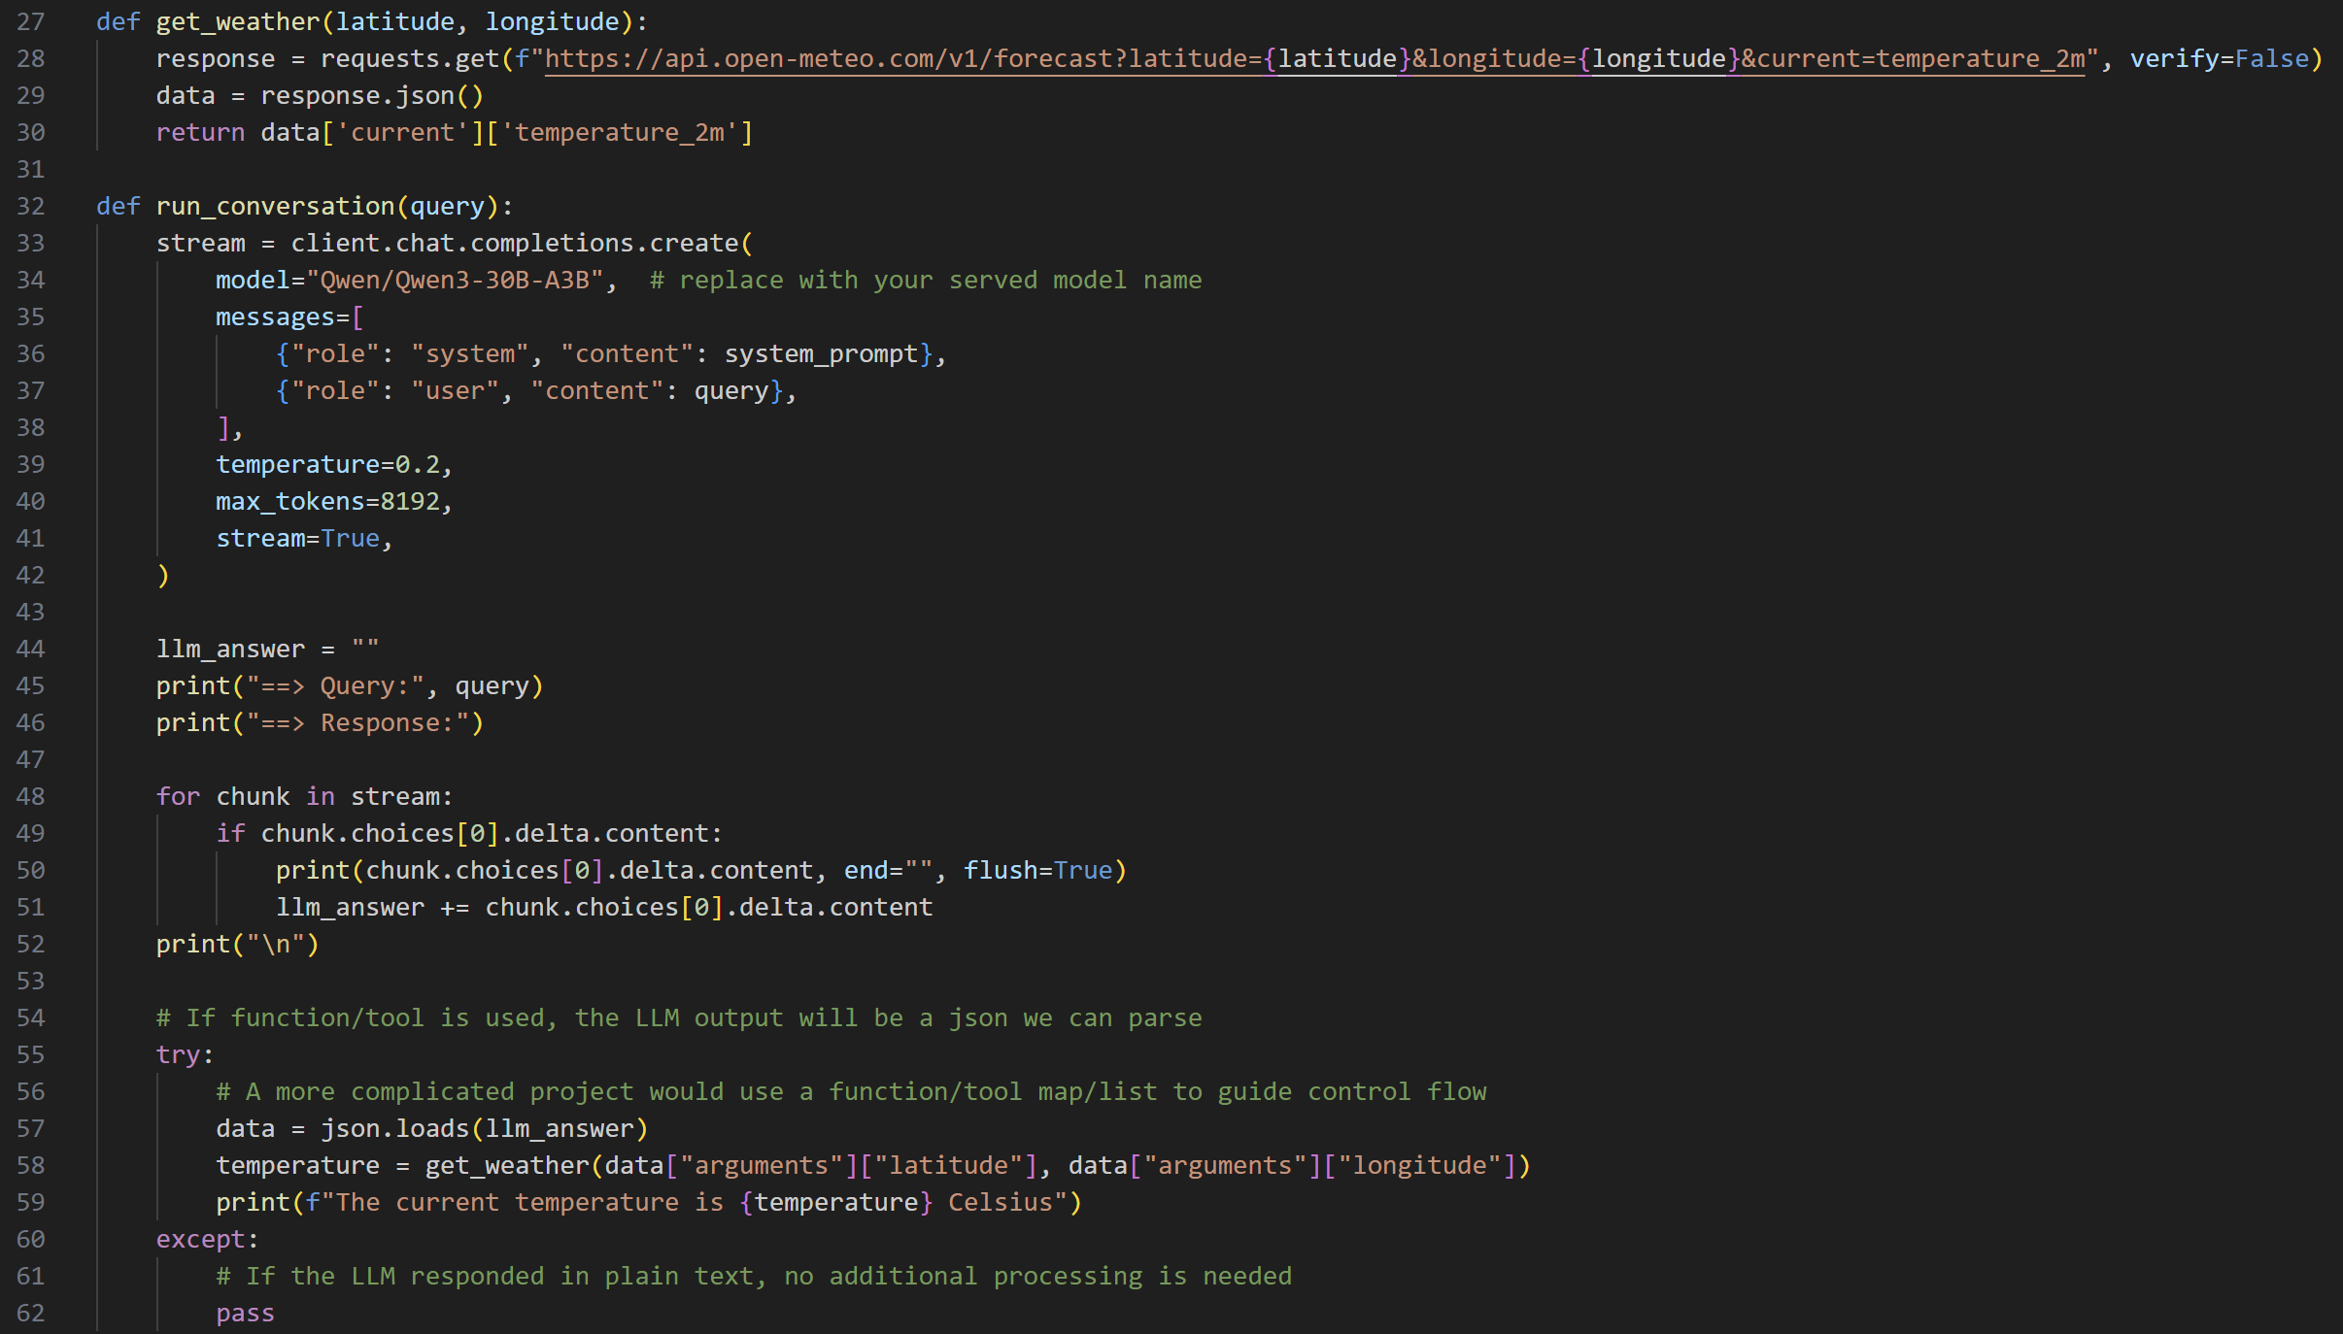
Function Calling Example: API Integration (vllm_function_calling.py)
API call
temperature_2m is temperature 2 meters above ground
Parse LLM output (string) into json
Fill in the API’s signature using the LLM’s structured output accordingly, then call the API

Slide 58
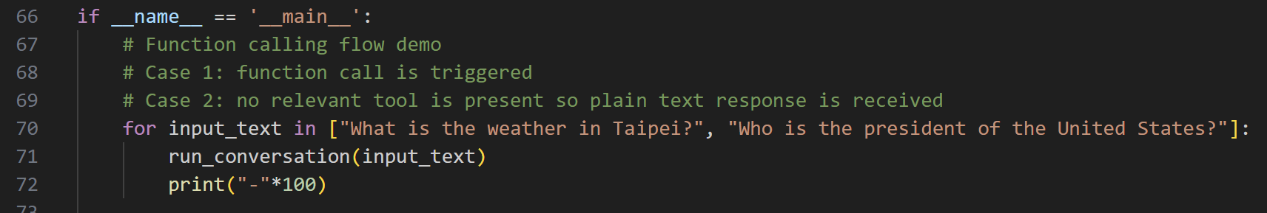
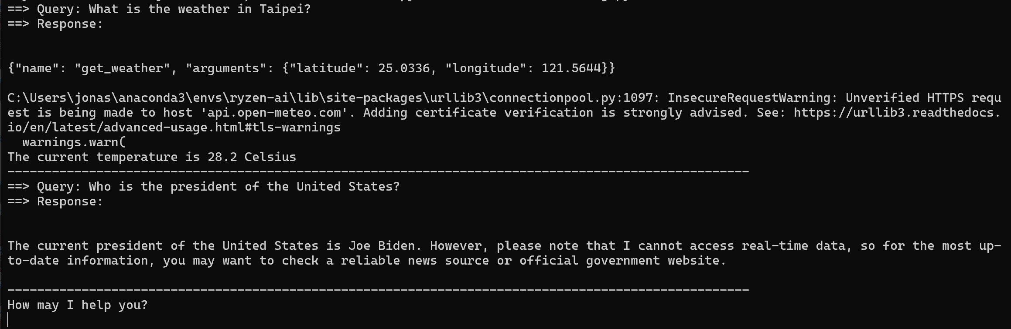
Function Calling Example: Output (vllm_function_calling.py)

Slide 59

Further Reading/Resources
AMD MI300 server availability: 4/29-5/3
AMD AI Developer Program
Complete modules on the website to earn AMD programming certification
Recommended modules related to today’s topics:
AI Agents 101: Building AI Agents with MCP and Open-Source Inference
Introduction to RAG
Today’s source code: https://github.com/jonathansimple/intro-to-llms
Function calling progression: AI agents, MCP, Openclaw/Claude Code
QR code for AMD AI Developer Program signup

Slide 60
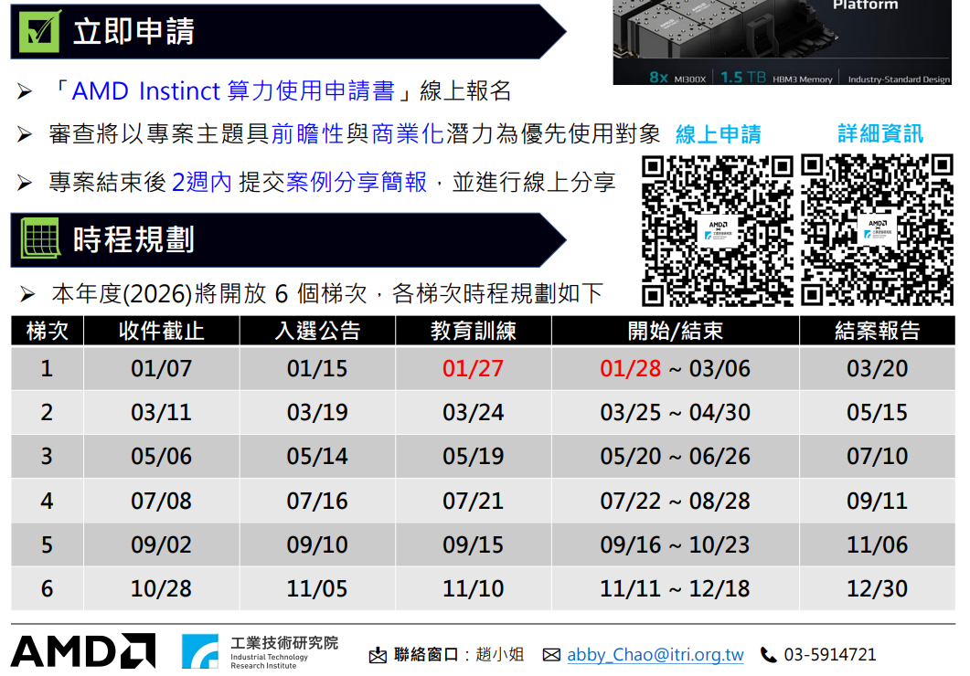
MLSteam Platform Application

Slide 61
Conclusion
In this course, we discussed how to:
Perform function calling using LLMs
Improve a LLM's factual accuracy without fine tuning using RAG
To do this, we covered:
What are LLMs, tokenizers, and function calling
How to craft prompts to maximize a LLM's potential
How to inference using a variety of platforms (transformers, Ollama, LM studio)
How to fine tune a LLM

Slide 62
Preparations for Working With LLMs

Slide 63
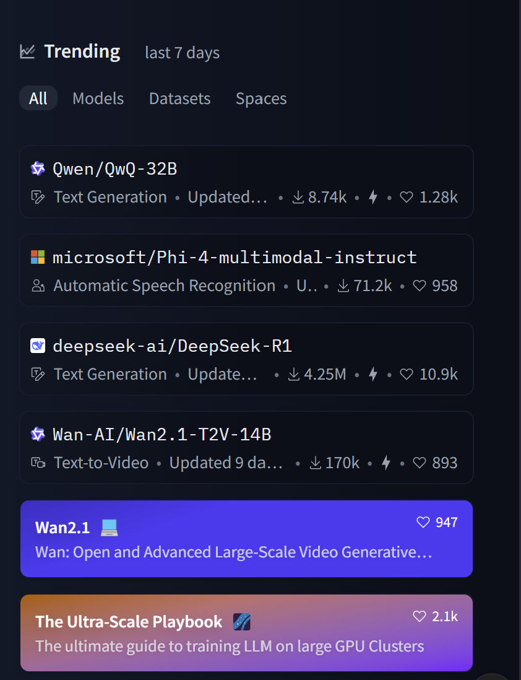
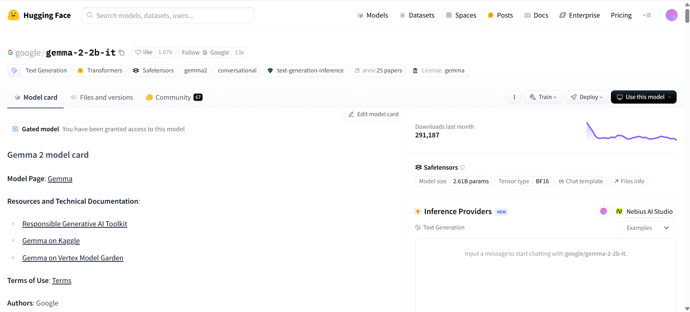
Downloading LLMs
Where to download models: https://huggingface.co/
You can find trending (new) models on the home page
Example of what a model’s Huggingface page looks like

Slide 64
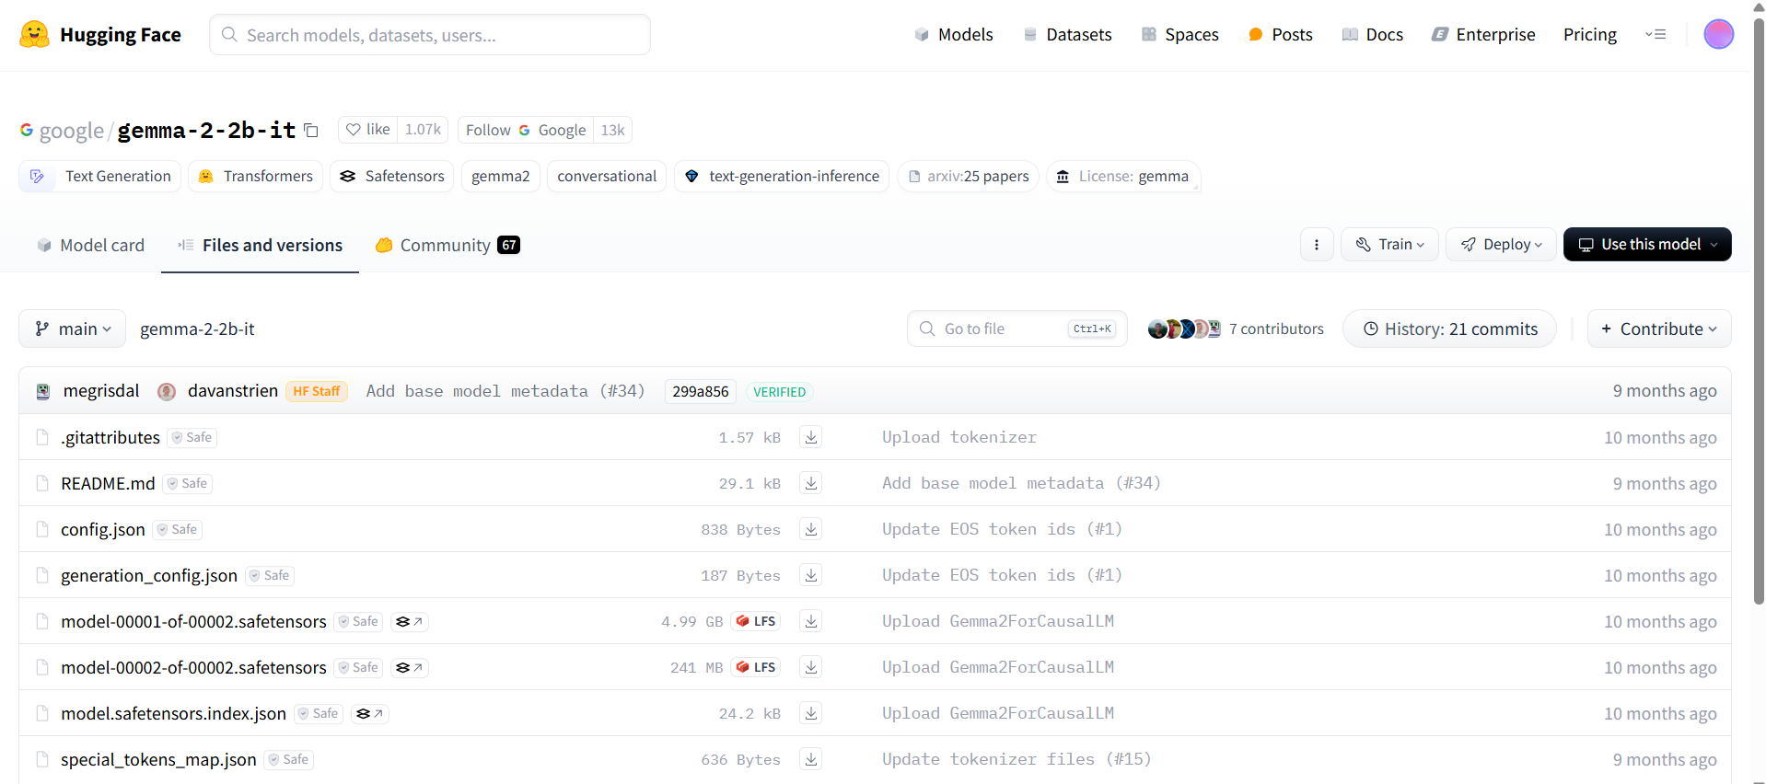
Downloading LLMs (1) – Manual Download

Slide 65
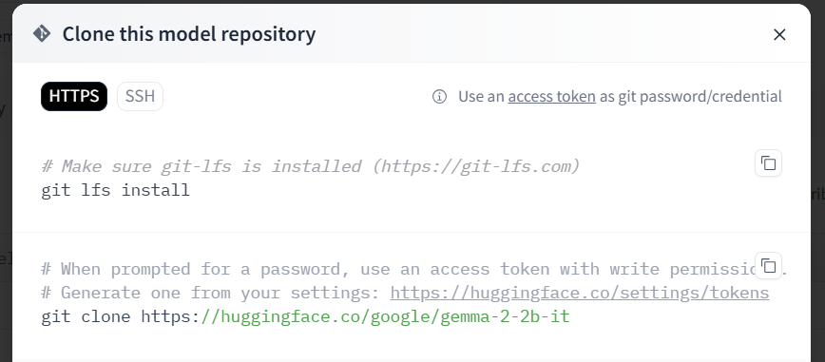
Downloading LLMs (2) - Git

Slide 66
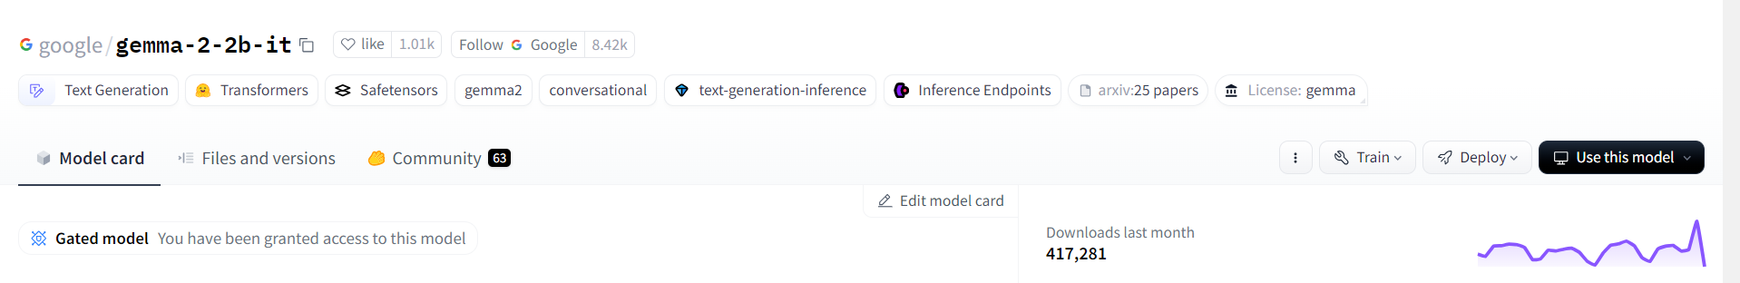
Downloading LLMs (3) – Huggingface/Transformers
google/gemma-2-2b-it
Running models hosted on Huggingface (this will save the models inside the Huggingface library folder):
tokenizer = AutoTokenizer.from_pretrained("google/gemma-2-2b-it", trust_remote_code=True)
model = AutoModelForCausalLM.from_pretrained("google/gemma-2-2b-it", trust_remote_code=True, device_map=0)
Running local/downloaded model:
tokenizer = AutoTokenizer.from_pretrained("/home/sean/Desktop/qlora-main/gemma2-2b-it", trust_remote_code=True)
model = AutoModelForCausalLM.from_pretrained("/home/sean/Desktop/qlora-main/gemma2-2b-it", trust_remote_code=True, device_map=0)

Slide 67
Huggingface Access Tokens
Some models on Huggingface are gated, meaning you need permission to download them
Usually all this entails is accepting their license, some models are gated behind a paywall instead
In such cases, you need to provide your Huggingface account’s access tokens in order to download the model using methods 2 and 3
Manually downloading from the webpage while logged in bypasses the need to provide access tokens

Slide 68
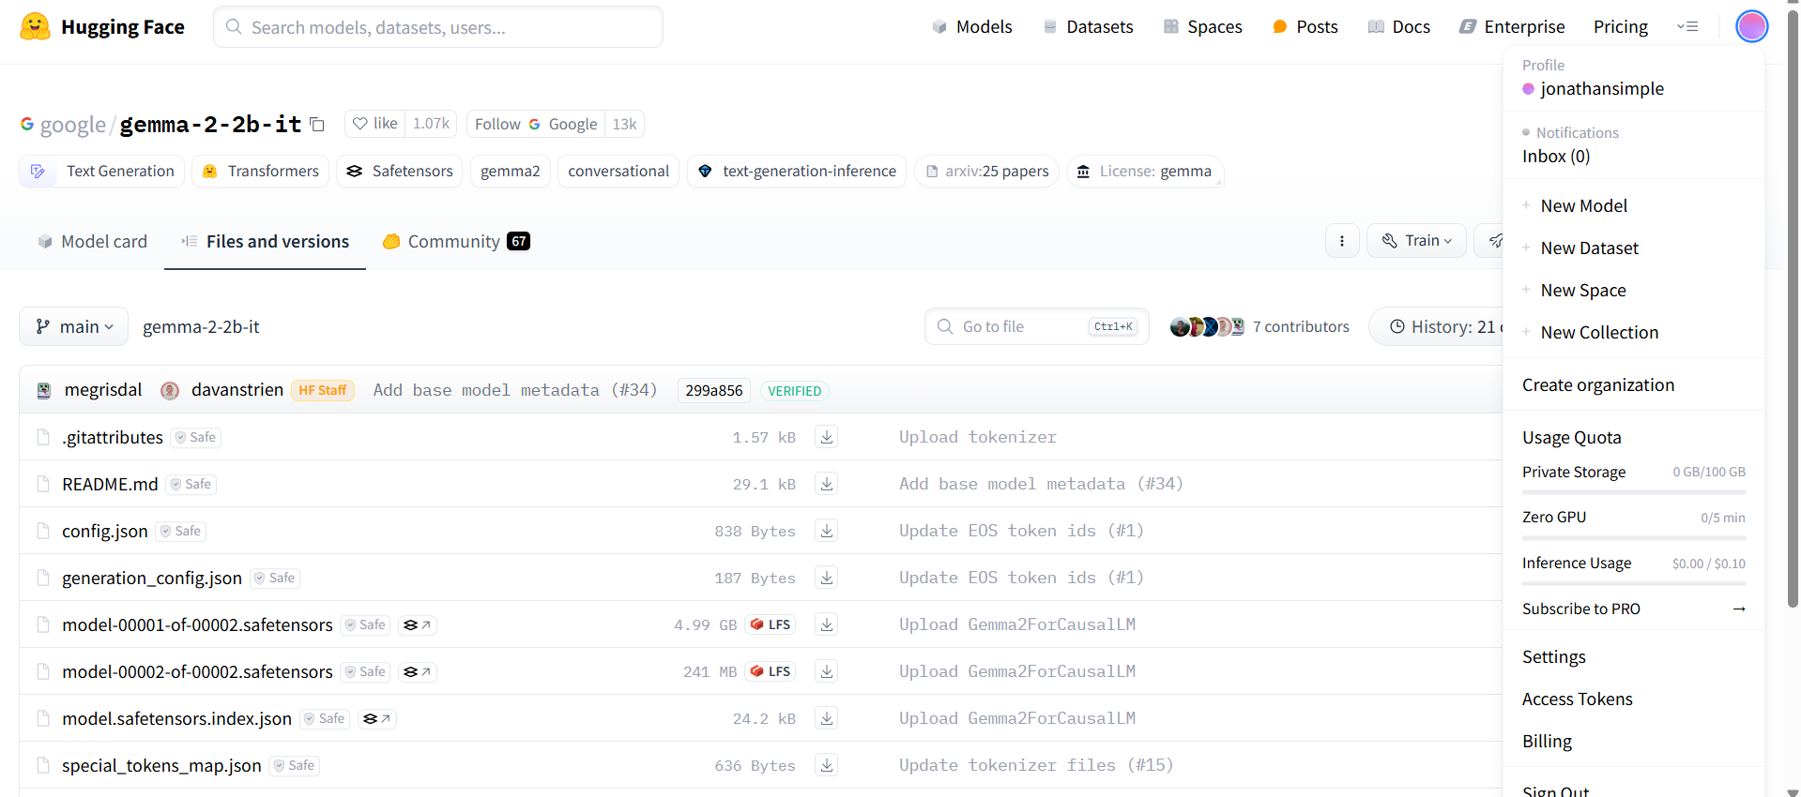
How to Create Your Huggingface Access Tokens
Under account profile, find the “Access Tokens” category (you can also get there via Settings)

Slide 69
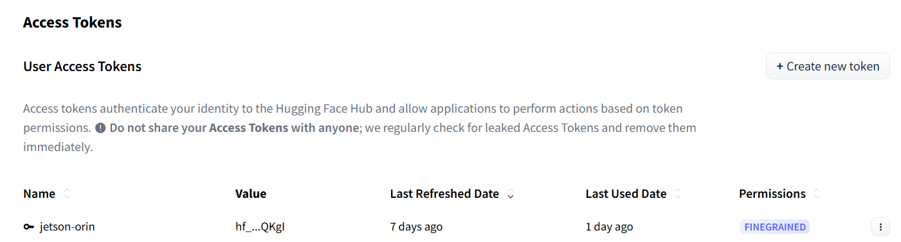
How to Create Your Huggingface Access Tokens
Create your token with the desired read/write privilege and copy it for the next step

Slide 70
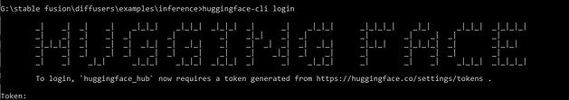
How to Provide Your Huggingface Access Tokens
Method 1: log into huggingface in your conda environment
Install huggingface_hub with command line interface
pip install -U “huggingface_hub[cli]”
Log in using your access token
huggingface-cli login

Slide 71
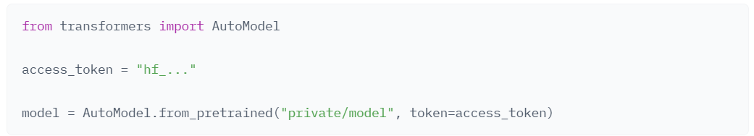
How to Provide Your Huggingface Access Tokens
Method 2: provide your access tokens when you call from_pretrained() [the function that pulls the model]
Notes:
https://huggingface.co/docs/hub/security-tokens

Slide 72
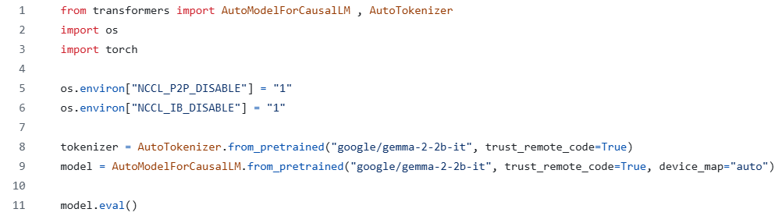
Transformers Example: Imports + Model Loading
If your system doesn’t support P2P GPU communication or InfiniBand (IB), set these environment variables otherwise your program may crash
Replace “google/…” with the path to the folder containing your LLM if you want to load your model + tokenizer from local file
Source code: inference_transformers.py

Slide 73
LLM Deployment Using Transformers

Slide 74
Inferencing with Transformers
Now that we have loaded our model, we can proceed to inferencing
Five main steps:
Generation configuration
Query formatting
Tokenize
Generate/inference
Decode

Slide 75
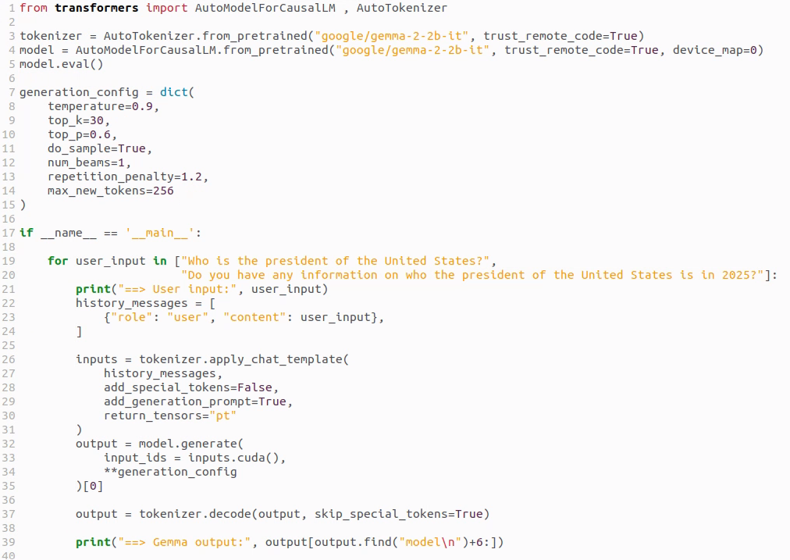
Inference Code Example (modified inference_transformers.py to fit on screen)
1. Set temperature to 0 (or do_sample to False) for deterministic outputs
1. Beam search setting: >1 for less randomness, ==1 for creativity
1. Sets the maximum length of the LLM’s response
2. Generate a new chat session + specify whom (system/user/LLM) this string belongs to
3. Tokenize: convert chat log (string) to tokens
4. Inference step (output is tokens)
5. Convert output tokens to string
Notes:
num_beams controls how many candidate sequences the model keeps track of during beam search decoding.
When to use num_beams
Use beam search (i.e., num_beams > 1) for tasks like:
Summarization
Translation
QA (when deterministic output is better)
When you want higher-quality, less random outputs
Don’t use it when you want:
Randomness/creativity → use do_sample=True instead
If you use num_beams > 1, make sure: do_sample = False
Otherwise the sampling randomness conflicts with beam search logic.

Slide 76
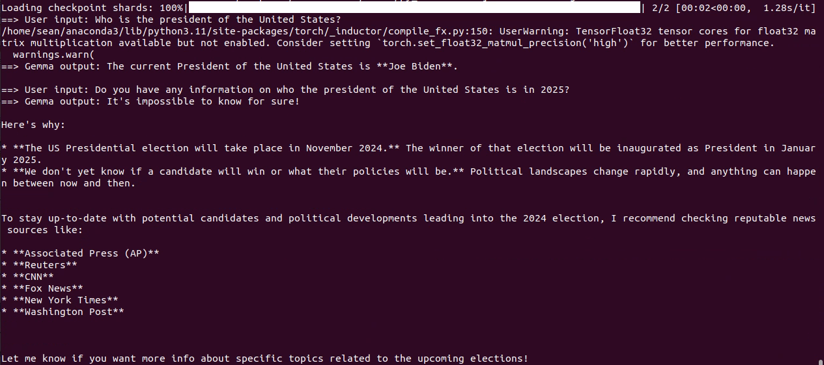
Inference Code Example: Output (inference_transformers.py)
This query exposes the older model’s outdated knowledge base

Slide 77
LLM Deployment Alternatives

Slide 78
LLM Deployment Tools
Feature | Transformers | Ollama | vLLM
Primary Use | Running, fine-tuning, and deploying LLMs | Local, easy-to-use deployment of LLMs | High-performance LLM inference and serving
User Interface | Python code (CLI/Script-based) | CLI-based, simple for local models | API server / CLI-based, OpenAI-compatible serving
Hardware Requirements | Flexible (depends on model) | Light-weight, works on most systems | Best with modern GPUs; optimized for high-VRAM / multi-GPU setups
Deployment Scale | Small to large-scale (with proper setup) | Small to medium-scale (local use) | Medium to large-scale production serving
Target | Flexibility and ease of use for researchers | Simplicity and accessibility | Fast inference, batching, and scalable API serving
Performance | Slow | Fast | Very fast
Out of all the deployment options, transformers is the slowest, transformers is mostly intended for development and not deployment

Slide 79
Ollama
Great tool for hosting LLMs locally
Based on llama.cpp – optimized for speed
Works on Linux, Windows, macOS
Supports a wide variety of models – if you can’t find the model you are looking for, you can import your own model (in GGUF format)
Notes:
Benefits of locally hosting llms

Slide 80
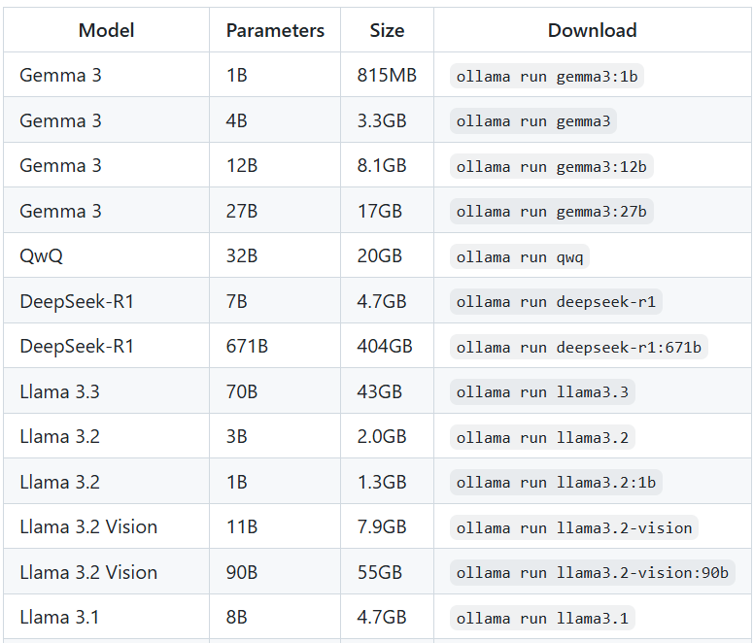
Setting Up Ollama (Linux)
Installation:
curl -fsSL https://ollama.com/install.sh | sh
Downloading a model:
ollama pull gemma3:1b-it-qat
Running a model:
ollama run gemma3:1b-it-qat
Print out all available (downloaded) models
ollama list
A non-exhaustive list of readily available models

Slide 81
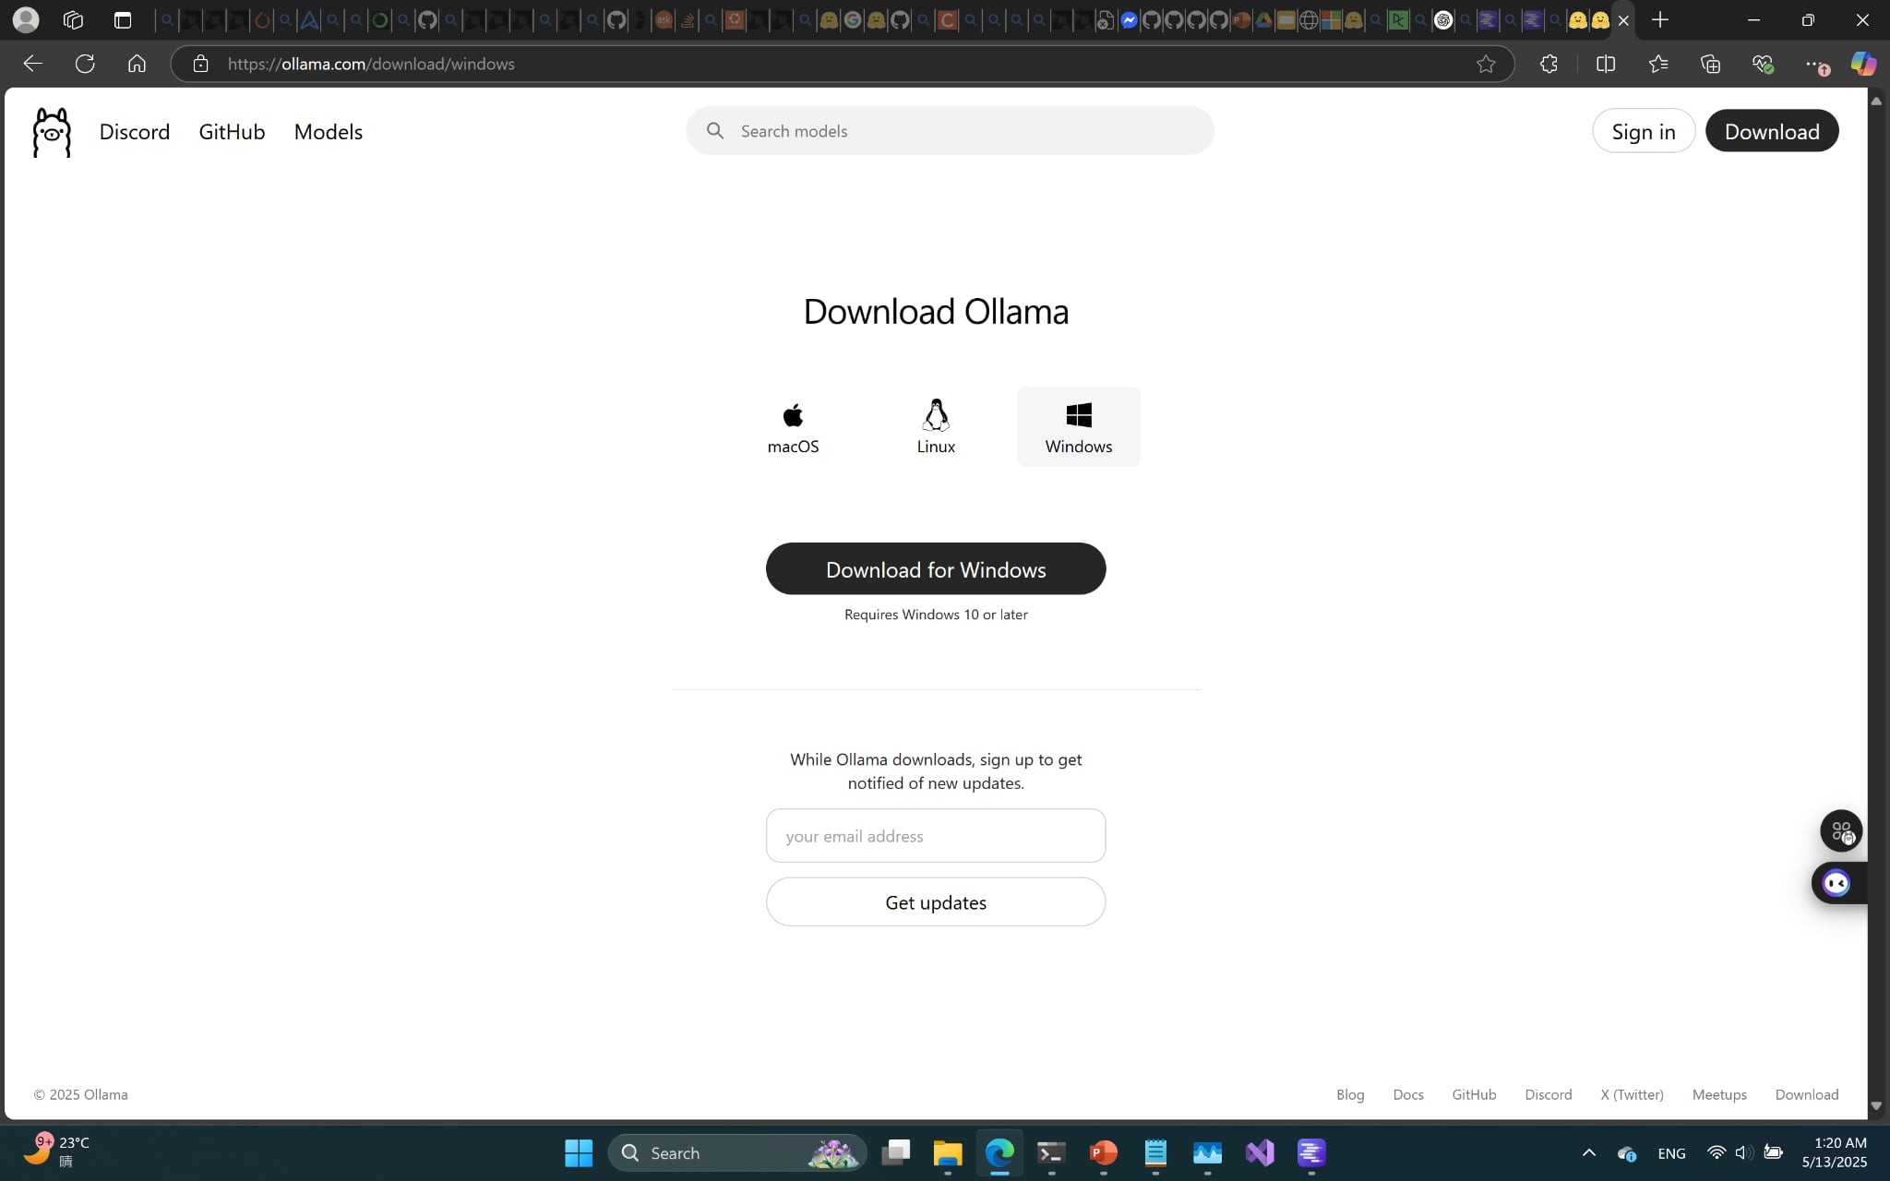
Setting Up Ollama (Windows)
A straightforward installer is available for Windows (simply download and run)

Slide 82
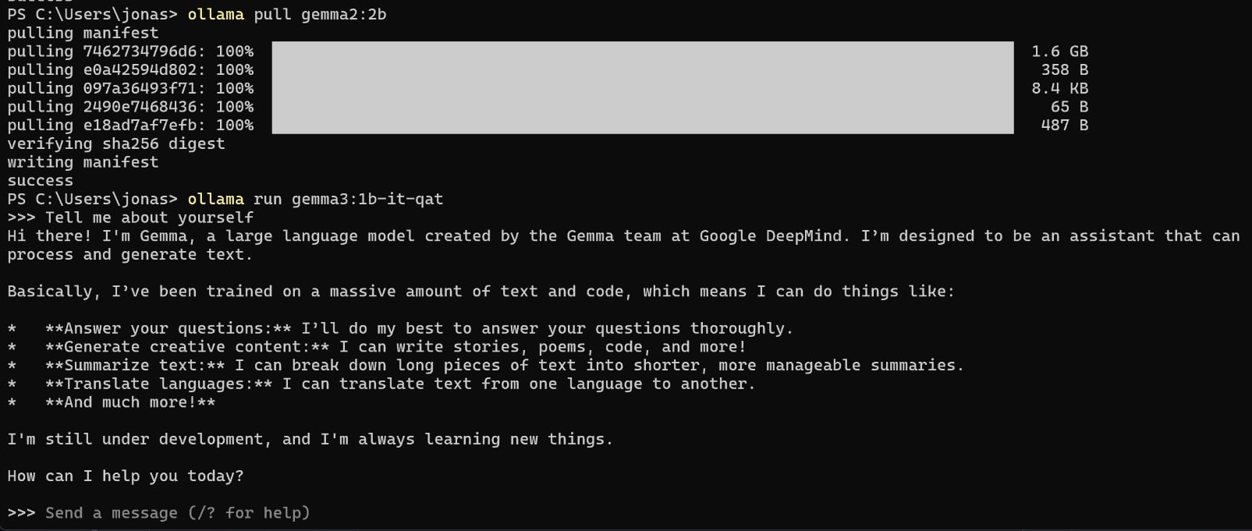
Running Ollama as a Chatbot on Command Line
Use the command: ollama run gemma3:1b-it-qat

Slide 83
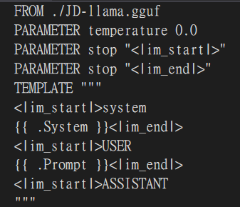
Working With Modelfiles in Ollama (Linux)
With Modelfiles, you can have greater control over the LLM hosted on Ollama
Running your own model:
>>> ollama create mymodel –f modelfile.txt
>>> ollama run mymodel
Quantizing a model:
>>> ollama create --quantize q4_K_M mymodel_q –f modelfile.txt
>>> ollama run mymodel_q
An example of what a Modelfile would look like. The FROM line is mandatory (path to the model)

Slide 84
Using Ollama as a Server
A command line chatbot isn’t very useful, but Ollama can be used as a server to handle query requests
How do we set up an Ollama server?
On your machine’s bootup, Ollama should already be running by default, if not, run ollama serve
What models are available?
All of the model listed when you call ollama list
What is the server’s address?
By default, the Ollama server is posted on http://localhost:11434/v1

Slide 85

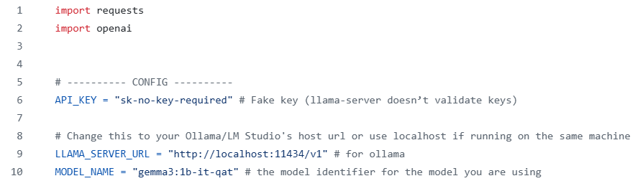
Sending a Query to Your Ollama Server (inference_ollama.py)
List of available LLMs
The model name should match that shown in ollama list

Slide 86
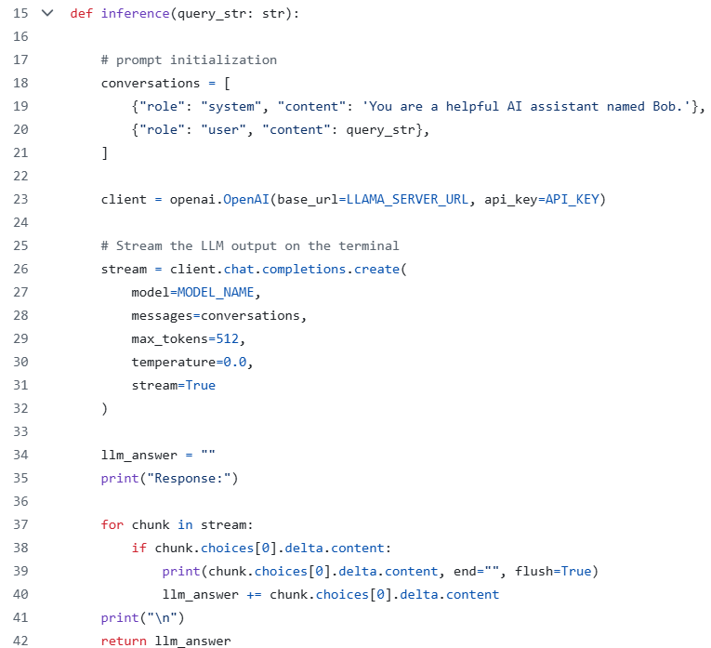
Sending a Query to Your Ollama Server (inference_ollama.py)
Label your query and add any system prompts you wish
Create a client pointing to your Ollama server
The chat completion is where you specify which model you wish to use (notice how you are not explicitly calling tokenizers now, it’s all being done beneath the hood)
Because we set stream=True, the LLM tokens will be streamed to the terminal in real time

Slide 87
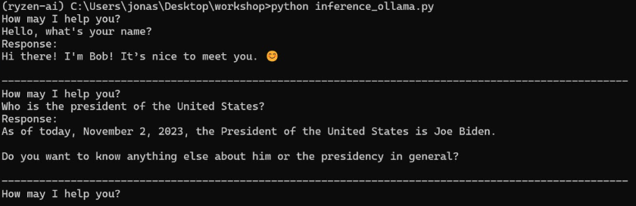
Using Ollama as a Server (inference_ollama.py)

Slide 88
Quiz: Function Calling Using Local LLMs (Ollama)
Using the function calling prompt crafted earlier, successfully call the open-meteo API using function calling with the gemma2:2b model on Ollama.
Correctly configuring your Ollama server (20%)
Correctly importing the open-meteo API (20%)
Correctly parsing your LLM output as a json (you may need to do some string manipulation to get the correct formatting) (20%)
Using the LLM’s outputted json, call the open-meteo API and get the current weather in Taipei using the prompt: “What is the weather in Taipei?” (40%)
Hint: gemma2:2b knows the longitude and latitude coordinates of most major cities, so with the proper function calling tool list description, the LLM should automatically return Taipei’s coordinates in its function calling output

